Slide 1
UPPER SIXTH ARTS
GEOGRAPHY
Lesson 14: What is Manufacturing?
What is Manufacturing?
Notes:
Good morning, class, and welcome to our geography lesson. I am your geography teacher, Mr Kamdem. Today we are starting Lesson 14: What is Manufacturing?.

Slide 2
CLASS INFO
Class, Chapter and Duration
Class | Upper Sixth Arts
Chapter | Module 6: Understanding and managing the dynamics of economic activities across the world in general and Cameroon in particular
Duration | 2 periods (2 × 50 minutes)
Notes:
This lesson is for Upper Sixth Arts. It belongs to Module 6: Understanding and managing the dynamics of economic activities across the world in general and Cameroon in particular. We shall need 2 periods to cover it.

Slide 3
IDENTIFICATION
Lesson Identification
Topic | Nature of Manufacturing Industries
Sub-topic | Nature of Manufacturing Industries
Lesson | Lesson 14: What is Manufacturing?
Notions / Concepts | Industry, manufacturing, primary, secondary, tertiary, quaternary, heavy industry, light industry, industrial system.
Syllabus focus | Meaning and classification of industries; the industrial system.
Competence | Learners are able to classify industries and describe the industrial system.
Notes:
Our topic is Nature of Manufacturing Industries, and the sub-topic is Nature of Manufacturing Industries. The key notions we shall use today are: industry, manufacturing, primary, secondary, tertiary, quaternary, heavy industry, light industry, industrial system. At the end, you should be able to do this: learners are able to classify industries and describe the industrial system.

Slide 4

HOMEWORK CORRECTION
Correction of the Homework
Question (Further Study 4: Management of Water Resources in Cameroon):
Describe how water is used in your area.
Notes:
Before we start the new lesson, let us correct the homework I gave you at the end of Further Study 4: Management of Water Resources in Cameroon. The question was: Describe how water is used in your area. Take out your exercise books.

Slide 5
HOMEWORK CORRECTION
Correction: Possible Answer
In Garoua, water from the Benue and boreholes is used for drinking, washing, watering gardens, brick-making, fishing and irrigating rice around Lagdo.
Notes:
Here is a good answer. In Garoua, water from the Benue and boreholes is used for drinking, washing, watering gardens, brick-making, fishing and irrigating rice around Lagdo. Compare it with your own answer and correct your work in red.

Slide 6
LESSON PLAN
Lesson Plan
Correction of the homework
Objectives and recall
Real-life situation and action to take
Learning activities
Board summary
Evaluation, remediation and homework
Notes:
Here is the plan of our lesson today. First, we shall correct the homework. Then we shall look at the objectives and recall what you already know. After that, we shall study a situation from real life and the action to take, and do the learning activities. Finally, we shall copy the board summary, do the evaluation and the remediation, and I will give you the homework.

Slide 7
OBJECTIVES
Objectives
By the end of this lesson, you should be able to:
Define manufacturing industry.
Classify industries.
Describe the industrial system.
Notes:
By the end of this lesson, you should be able to do three things. Number 1: define manufacturing industry. Number 2: classify industries. Number 3: describe the industrial system.

Slide 8
PREVIOUS KNOWLEDGE
Previous Knowledge
Raw materials come from farms, mines and forests.
A system has inputs, processes and outputs.
Notes:
Let us first remember what you already know. Raw materials come from farms, mines and forests. A system has inputs, processes and outputs. Keep this in mind, because we shall build on it today.

Slide 9
REAL-LIFE SITUATION
Situation in Real Life
In Douala, a brewery turns maize, water and malt into beer; in Garoua, CICAM turns cotton into cloth. A learner asks what makes these activities "manufacturing".
Notes:
Listen carefully to this situation from real life. In Douala, a brewery turns maize, water and malt into beer; in Garoua, CICAM turns cotton into cloth. A learner asks what makes these activities "manufacturing". Think about it, because I am going to ask you some questions.

Slide 10
REAL-LIFE SITUATION
Situation: Question 1
What is the problem in the situation?
Notes:
Question 1: What is the problem in the situation? Think for a moment, then raise your hand to answer.

Slide 11
REAL-LIFE SITUATION
Answer
Learners want to define manufacturing.
Notes:
Good. Learners want to define manufacturing.

Slide 12
REAL-LIFE SITUATION
Situation: Question 2
What do the factories do?
Notes:
Question 2: What do the factories do? Think for a moment, then raise your hand to answer.

Slide 13
REAL-LIFE SITUATION
Answer
They change raw materials into finished products.
Notes:
Good. They change raw materials into finished products.

Slide 14
REAL-LIFE SITUATION
Situation: Question 3
To which sector do they belong?
Notes:
Question 3: To which sector do they belong? Think for a moment, then raise your hand to answer.

Slide 15
REAL-LIFE SITUATION
Possible Answer
The secondary sector.
Notes:
Good. The secondary sector.

Slide 16
ACTION TO TAKE
Action to Take
Promote local processing of raw materials to create jobs.
Notes:
From this situation, the action we are working towards in this lesson is the following: promote local processing of raw materials to create jobs.

Slide 17
JUSTIFICATION
Justification of the Lesson
This lesson introduces industry, a key driver of development.
Notes:
Why is this lesson important for you? This lesson introduces industry, a key driver of development.

Slide 18

1. MEANING
Activity 1
A bottling line in a brewery.
Notes:
Activity 1. Look carefully at this picture: a bottling line in a brewery. Observe every detail before I ask the question.

Slide 19
1. MEANING
Activity 1: Question
What is manufacturing?
Notes:
Here is the question for Activity 1: What is manufacturing? Take one minute to think and write your answer in your rough notebook.

Slide 20
1. MEANING
Activity 1: Answer
Changing raw materials into finished goods in factories.
Notes:
Let us check the answer together. Changing raw materials into finished goods in factories.

Slide 21
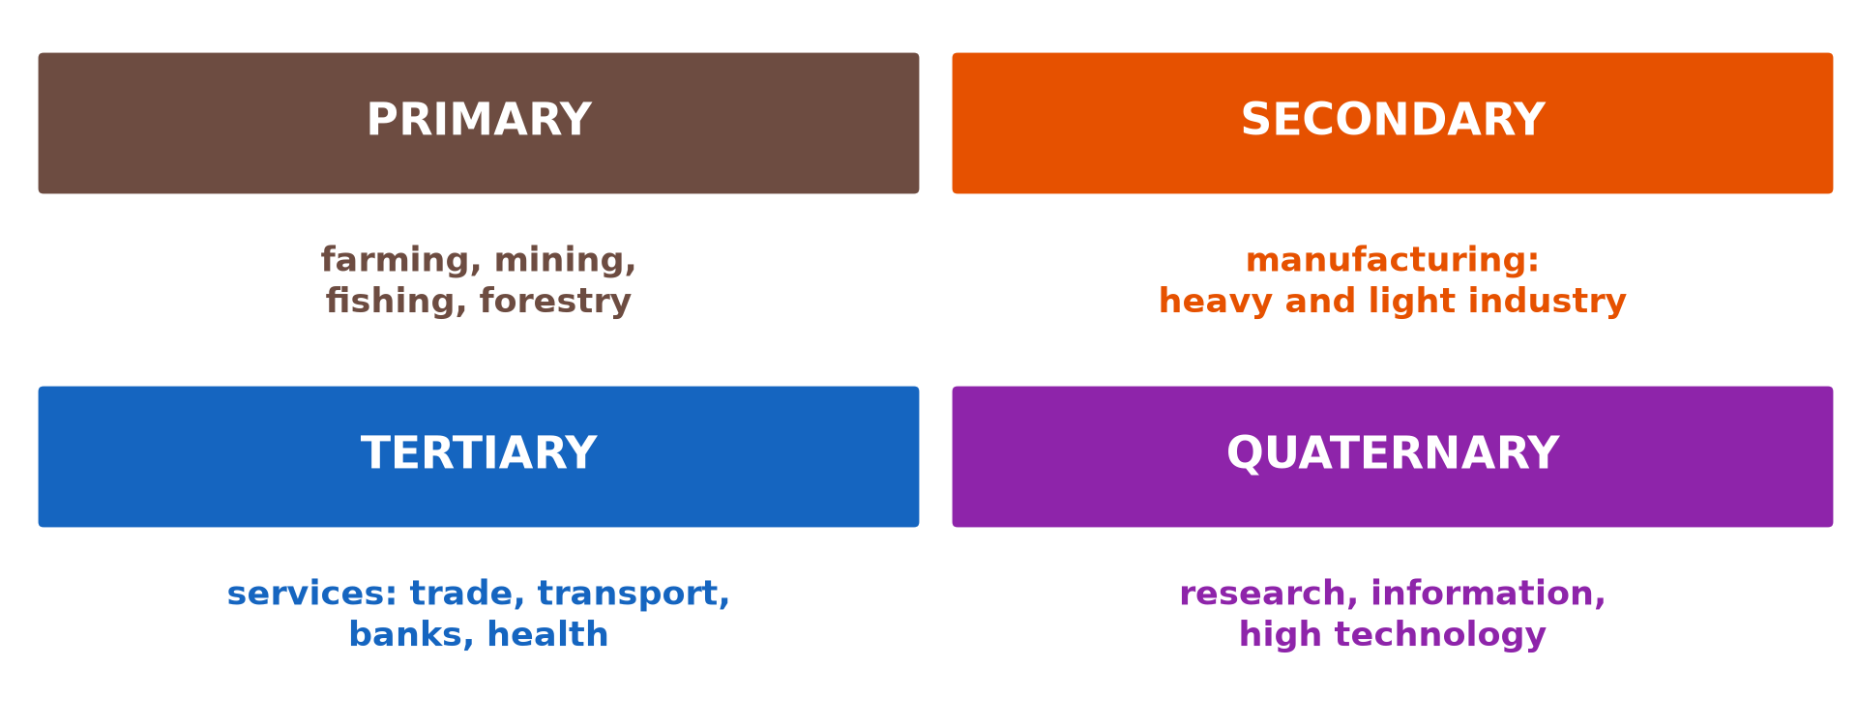
2. CLASSIFICATION
Activity 2
The four economic sectors.
Notes:
Activity 2. Look carefully at this diagram: the four economic sectors. Observe every detail before I ask the question.

Slide 22
2. CLASSIFICATION
Activity 2: Question
To which sector do farming, factories and banks belong?
Notes:
Here is the question for Activity 2: To which sector do farming, factories and banks belong? Take one minute to think and write your answer in your rough notebook.

Slide 23
2. CLASSIFICATION
Activity 2: Answer
Primary, secondary and tertiary.
Notes:
Let us check the answer together. Primary, secondary and tertiary.

Slide 24

2. CLASSIFICATION
Activity 3
A steel works.
Notes:
Activity 3. Look carefully at this picture: a steel works. Observe every detail before I ask the question.

Slide 25
2. CLASSIFICATION
Activity 3: Question
Distinguish heavy and light industry.
Notes:
Here is the question for Activity 3: Distinguish heavy and light industry. Take one minute to think and write your answer in your rough notebook.

Slide 26
2. CLASSIFICATION
Activity 3: Answer
Heavy: bulky raw materials and products (steel). Light: small goods (clothes, electronics).
Notes:
Let us check the answer together. Heavy: bulky raw materials and products (steel). Light: small goods (clothes, electronics).

Slide 27
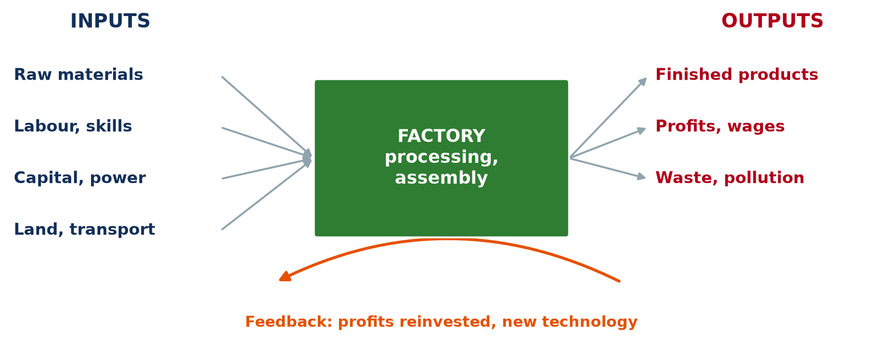
3. THE INDUSTRIAL SYSTEM
Activity 4
The factory as a system.
Notes:
Activity 4. Look carefully at this diagram: the factory as a system. Observe every detail before I ask the question.

Slide 28
3. THE INDUSTRIAL SYSTEM
Activity 4: Question
Name two inputs and two outputs of a factory.
Notes:
Here is the question for Activity 4: Name two inputs and two outputs of a factory. Take one minute to think and write your answer in your rough notebook.

Slide 29
3. THE INDUSTRIAL SYSTEM
Activity 4: Answer
Inputs: raw materials, labour. Outputs: products, waste.
Notes:
Let us check the answer together. Inputs: raw materials, labour. Outputs: products, waste.

Slide 30

3. THE INDUSTRIAL SYSTEM
Activity 5
A textile factory.
Notes:
Activity 5. Look carefully at this picture: a textile factory. Observe every detail before I ask the question.

Slide 31
3. THE INDUSTRIAL SYSTEM
Activity 5: Question
What is the feedback in an industrial system?
Notes:
Here is the question for Activity 5: What is the feedback in an industrial system? Take one minute to think and write your answer in your rough notebook.

Slide 32
3. THE INDUSTRIAL SYSTEM
Activity 5: Answer
Profits are reinvested in new machines and technology.
Notes:
Let us check the answer together. Profits are reinvested in new machines and technology.

Slide 33
BOARD SUMMARY
Board Summary
Topic: Nature of Manufacturing Industries
Sub-topic: Nature of Manufacturing Industries
Lesson 14: What is Manufacturing?
Notes:
Now we are going to copy the board summary. Write the title and the headings neatly in your notebooks. I will give you enough time for each slide, so do not rush.

Slide 34
BOARD SUMMARY
1. Meaning and Classification of Manufacturing
Manufacturing can be understood as follows:
Manufacturing: It is the transformation of raw materials or parts into finished goods, usually in factories.
Notes:
Let us copy Meaning and Classification of Manufacturing. Manufacturing can be understood as follows. On this slide we have Manufacturing. Write each point on a new line, with the key term first, and explain it in your own words when we revise. When you finish, we go to the next slide.

Slide 35
BOARD SUMMARY
1. Meaning and Classification of Manufacturing (continued)
Classification by sector: Primary industries extract resources, secondary industries manufacture goods, tertiary industries give services and quaternary industries deal with research and information.
Notes:
We continue with Meaning and Classification of Manufacturing. On this slide we have Classification by sector. Write each point on a new line, with the key term first, and explain it in your own words when we revise. When you finish, we go to the next slide.

Slide 36
BOARD SUMMARY
1. Meaning and Classification of Manufacturing (continued)
Other classifications: Heavy industries use bulky raw materials and produce bulky goods (steel, ships); light industries produce small goods (clothes, electronics). Industries can also be classed as raw-material, market or footloose.
Notes:
We continue with Meaning and Classification of Manufacturing. On this slide we have Other classifications. Write each point on a new line, with the key term first, and explain it in your own words when we revise.

Slide 37
BOARD SUMMARY
1. Meaning and Classification of Manufacturing
Illustration: classification of industries
Notes:
Now draw this illustration in your notebook: classification of industries. Give it a title and label it clearly.

Slide 38
BOARD SUMMARY
2. The Industrial (Manufacturing) System
A factory works as a system:
Inputs: Raw materials, energy, labour, capital, land and transport enter the factory. Knowledge and management are also inputs.
Notes:
Let us copy The Industrial (Manufacturing) System. A factory works as a system. On this slide we have Inputs. Write each point on a new line, with the key term first, and explain it in your own words when we revise. When you finish, we go to the next slide.

Slide 39
BOARD SUMMARY
2. The Industrial (Manufacturing) System (continued)
Processes and outputs: Processing, assembling, packaging and storing are the processes. Outputs are finished products, profits, wages and waste.
Feedback: Profits are reinvested in new machines and research. Losses may lead to closure.
Notes:
We continue with The Industrial (Manufacturing) System. On this slide we have Processes and outputs and Feedback. Write each point on a new line, with the key term first, and explain it in your own words when we revise.

Slide 40
BOARD SUMMARY
2. The Industrial (Manufacturing) System
Illustration: the industrial system
Notes:
Now draw this illustration in your notebook: the industrial system. Give it a title and label it clearly.

Slide 41
FORMATIVE EVALUATION
Evaluation 1
Distinguish heavy and light industry with examples.
Notes:
Now let us check what you have understood. Question 1: Distinguish heavy and light industry with examples. Answer in your exercise book.

Slide 42
FORMATIVE EVALUATION
Expected Answer
Heavy: steel, shipbuilding. Light: clothing, electronics.
Notes:
The expected answer is: heavy: steel, shipbuilding. Light: clothing, electronics. If you got it right, well done.

Slide 43
FORMATIVE EVALUATION
Evaluation 2
Name the four economic sectors.
Notes:
Now let us check what you have understood. Question 2: Name the four economic sectors. Answer in your exercise book.

Slide 44
FORMATIVE EVALUATION
Expected Answer
Primary, secondary, tertiary and quaternary.
Notes:
The expected answer is: primary, secondary, tertiary and quaternary. If you got it right, well done.

Slide 45
REMEDIATION
Remediation
Fill in the blanks:
Manufacturing belongs to the ______ sector.
Steel making is ______ industry.
Research belongs to the ______ sector.
Notes:
For those who need more practice, fill in the blanks in your exercise book. The answers are: number 1, secondary; number 2, heavy; number 3, quaternary.

Slide 46
HOMEWORK
Homework
Draw a factory in your area as a system.
Notes:
For your homework: Draw a factory in your area as a system. We shall correct it at the beginning of our next lesson.

Slide 47
NEXT LESSON
Next Lesson
Our next lesson will be on:
Lesson 15: Industrial Location
Notes:
Our next lesson will be on Lesson 15: Industrial Location. Thank you for your attention, and see you next time.

Slide 48
BILINGUAL GAME
Bilingual Game (Jeu Bilingue)
English | Français
Industry | L'industrie
Factory | L'usine
Raw material | La matière première
Finished good | Le produit fini
Sector | Le secteur
Assembly | L'assemblage
Notes:
Let us play the bilingual game. I say a word in English, and you give me the French word. Then we do the reverse.

Slide 49
LOGBOOK
Official Logbook (1/2)
Module / Topic | Nature of Manufacturing Industries
Lesson Title | Lesson 14: What is Manufacturing?
Expected Learning Outcomes | Define manufacturing industry. Classify industries. Describe the industrial system.
Competence | Learners are able to classify industries and describe the industrial system.
Notes:
I record this information in the official logbook of the class after the lesson.

Slide 50
LOGBOOK
Official Logbook (2/2)
Matter Taught | Meaning and Classification of Manufacturing; The Industrial (Manufacturing) System.
Evaluation | Formative evaluation and remediation exercise.
Homework | Draw a factory in your area as a system.
Enrolment / Present / Absent | ____ / ____ / ____
Achievement | To be completed after the lesson.
Notes:
I complete the second page of the logbook: the matter taught, the evaluation, the homework and the attendance.

Slide 51
TEACHER'S NOTE
Teacher's Note
Timing: Homework correction, plan, objectives 8 min | Recall, situation, action 10 min | 5 activities 30 min | Board summary (copying) 30 min | Evaluation, remediation 10 min | Homework, next lesson 5 min | Logbook 7 min
Without the projector (Activity 1): list factories in Cameroon.
Without the projector (Activity 2): sort jobs by sector.
Without the projector (Activity 3): give examples.
Without the projector (Activity 4): draw the system.
Without the projector (Activity 5): discuss CICAM.
Notes:
This slide is for me, the teacher: it gives the timing of the lesson and what to do if the projector is not available.

Slide 52
REFERENCES
References
National Geography Syllabus, MINESEC/IGE/IP-SS, 2019 — Module 6 (Economic Geography).
Photo, Activity 1: “Schneider Weisse bottling line” by Bernt Rostad, CC BY 2.0, via Flickr (https://www.flickr.com/photos/67975030@N00/8434576955)
Photo, Activity 3: “Belval steel works, Luxembourg, May 1995” by sludgegulper, CC BY-SA 2.0, via Flickr (https://www.flickr.com/photos/28179929@N08/4991135732)
Photo, Activity 5: “Lowell Massachusetts - Boott Cotton Mills Museum Weave Room” by Onasill ~ Bill- 81M views, CC BY-NC-SA 2.0, via Flickr (https://www.flickr.com/photos/7156765@N05/43677799854)
Diagrams and animations: drawn for this lesson (Geography Department).
Notes:
These are the references and picture credits used to prepare this lesson.

